Slide 1
Creatividad Inclusiva por medio de la Educación Artística
Fundamentos para la creación de arte educativo inclusivo
This project has been funded with the support from the European Union.
This material reflects the views only of the author, and the Commission cannot be held responsible for any use which may be made of the information contained therein.

Slide 2
Objectivos
Para saber cuáles son las bases de un arte educativo inclusivo, debemos descubrir más sobre:
Desarrollo positivo de los jóvenes
Diseño Universal para el Aprendizaje (DUA)
Arte-Terapia y Educación

Slide 3
Desarrollo Positivo Adolescente

Slide 4
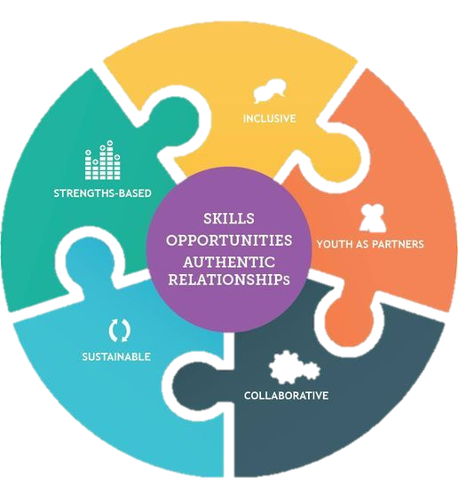
Desarrollo Positivo Adolescente
¿Qué es el Desarrollo Positivo Adolescente?
Un enfoque basado en los puntos fuertes en el que los jóvenes se desarrollan mediante la identificación y el perfeccionamiento de habilidades, competencias e intereses de una manera que les ayuda a alcanzar su pleno potencial.

Slide 5
Desarrollo Positivo Adolescente
Competencia
Confianza
El modelo de las 5C de Lerner
Conexión
Carácter
Compasión
+ 6 C - Contribución
Notes:
Lerner, a profesor of Human Development at Tufts University, and his colleagues proposed 5Cs as five important indicators of PYD.
Competence: includes cognitive, social, academic and vocational competences.
Confidence: refers to individual’s view of his/her global positive value and capacities.
Connection denotes an individual’s positive relationships with other people and organizations such as the exchanges between the individual and the social environment.
Character represents internal value standards for right behaviors and respect for social and cultural regulations.
Caring/compassion refers to the capacity of sympathizing and empathizing for others.
Furthermore, according to Lerner and his colleagues these five Cs would help shape the sixth C, contribution, that is active participation, developing and using leadership skills.

Slide 6
Desarrollo Positivo Adolescente
DPA y la adolescencia:
Nivel alto de PYD en preadolescentes actitud positiva y optimista
Nivel bajo de PYD en preadolescentes manifestación de comportamientos más negativo

Slide 7
DISEÑO UNIVERSAL PARA EL APRENDIZAJE (DUA)

Slide 8
DISEÑO UNIVERSAL PARA EL APRENDIZAJE (DUA)
¿Qué es el DUA?
Un enfoque para el diseño de planes de estudio -incluidos los objetivos, métodos, materiales y evaluaciones de la enseñanza- que sea lo suficientemente flexible desde el principio para adaptarse a las diferencias del alumnado.
Notes:
UDL aims at removing the barriers in the curriculum while building scaffolds, supports, and alternatives that meet the learning needs of a wide range of students.

Slide 9
DISEÑO UNIVERSAL PARA EL APRENDIZAJE (DUA)
El UDL se centra en 3 conceptos clave:
Proporcionar múltiples medios de compromiso: El PORQUÉ del aprendizaje
Proporcionar múltiples medios de representación: El QUÉ del aprendizaje
Proporcionar múltiples medios de acción y expresión: El CÓMO del aprendizaje
Notes:
The WHY of learning activates affective network for an enhanced outcome of the learning experience. Learners can be engaged and motivated to learn in a different way. 🡪Teachers need to provide multiple options for engagement (novelty or predictable routine and structure).
The ways students perceive information is diverse, due either to their sensory disabilities or preferences, or learning disabilities. 🡪 It is essential to offer information in more than one format.
Students express what they know differently in their learning environment, according to their problems (speaking, motor speech problems or language disorders. 🡪 Students should use more than one way to interact with the materials and show what they have learnt.

Slide 10
DISEÑO UNIVERSAL PARA EL APRENDIZAJE (DUA)
LOS PRINCIPIOS EN LA PRÁCTICA
Compromiso: Los alumnos difieren notablemente en las formas en que pueden estar comprometidos o motivados para aprender.
Representación: Los alumnos difieren en la forma en que perciben y comprenden la información que se les presenta.
Acción y expresión: Los alumnos difieren en la forma en que pueden navegar por un entorno de aprendizaje y expresar lo que saben.
Notes:
Engagement: This principle encompasses the ideas of motivation, building on the interests of the students. The area of engagement also helps students to see the reasons why they should learn what they’re learning, and makes it relevant to their life. This also includes helping students become self-motivated by guiding them through rubrics that allow for self-reflection and personal goals.
Representation: Customization is key here. This involves providing multiple ways to assimilate subject material, such as textbooks, audio files, digital books, or images and graphs. It also implies customization and flexibility within those formats. With this kind of flexibility, students have access to the material that best suits their needs. This is useful for children with disabilities such as dyslexia, as well as for average students who simply perform better when listening to instruction than when reading, for example.
Action and expression: Once students have taken in the information, it’s time for them to express and show what they’ve learned. This principle of universal design for learning takes into account the differences of students’ manner of expression. Flexibility is provided in the way that students show their knowledge of the subject, meaning they can choose not to perform a test and instead opt for a more adaptive expression that fits their strengths. Action and expression also touches on the idea of goal-setting for students. Here, teachers help students set goals for learning, and guide students through monitoring their own progress.

Slide 11
DISEÑO UNIVERSAL PARA EL APRENDIZAJE (DUA)
Planificación para todos los alumnos: un proceso de cuatro pasos
Paso 1: Establecer objetivos
Paso 2: Analizar el estado actual del plan de estudios y del aula
Paso 3: Aplicar el DUA al desarrollo de clases o unidades
Paso 4: Enseñar la clase o unidad DUA

Slide 12
ARTE-TERAPIA Y EDUCACIÓN

Slide 13
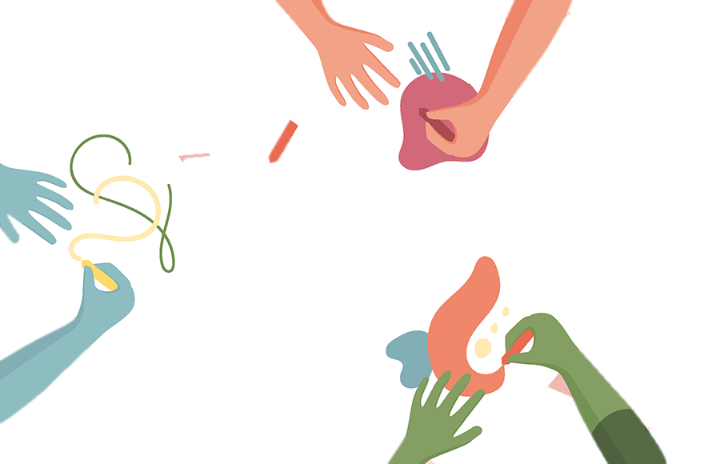
ARTE-TERAPIA Y EDUCACIÓN
La arteterapia se basa en la comprensión de que nuestras obras creativas pueden ayudarnos a entender quiénes somos, a expresar nuestros pensamientos y emociones que son imposibles de expresar con palabras.
Áreas de trabajo:
Terapia visual y plástica
Dramaterapia
Musicoterapia
Danzaterapia
Biblioterapia
Terapia de cuentos
Terapia de juegos
Terapia de movimiento.
Notes:
Art therapy is a technique rooted in the idea that creative expression can foster healing and mental well-being. The goal of art therapy is to utilize the creative process to help people explore self-expression and, in doing so, find new ways to gain personal insight and develop new coping skills. The creation or appreciation of art is used to help people explore emotions, develop self-awareness, cope with stress, boost self-esteem, and work on social skills.
Art therapy (psychotherapy using visual and plastic art).
Drama therapy (psychotherapy using drama and role games).
Music therapy (psychotherapy using music).
Dance therapy (psychotherapy using dance and movement).
Bibliotherapy (psychotherapy using poetry).
Fairy-tales therapy (psychotherapy using fairy tales).
Games therapy (psychotherapy using various forms of games).
Movement (or body) therapy.

Slide 14
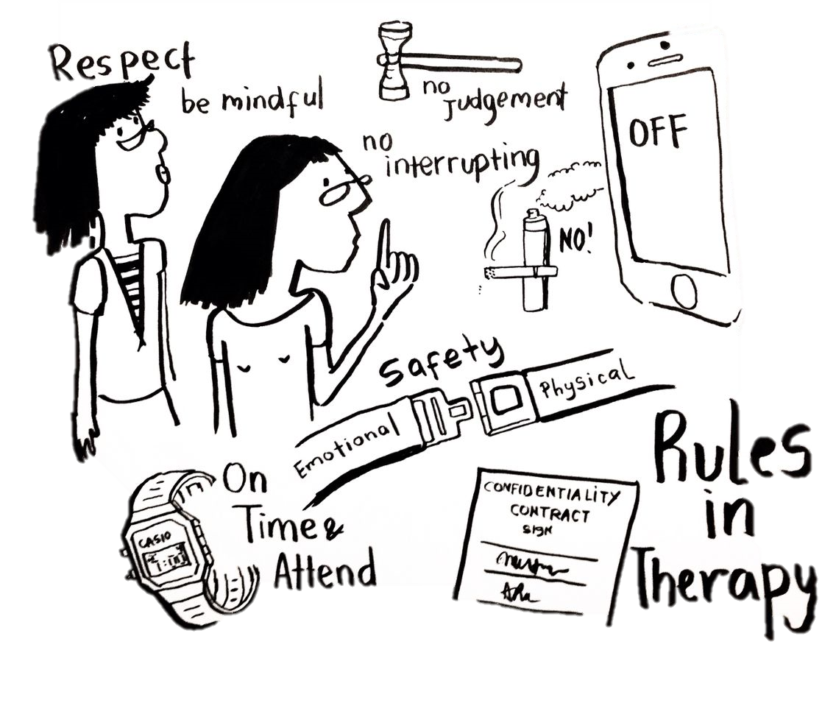
ARTE-TERAPIA Y EDUCACIÓN
¿Cuáles son las reglas de la arteterapia?
Confidencialidad
Espacio
Tiempo
Notes:
Confidentiality: is essential to create a safe therapeutic environment.
Space must be quiet, spacious and isolated from outside sounds.
Time allocation: the therapeutic space also depends on a proper time allocation

Slide 15
ARTE-TERAPIA Y EDUCACIÓN
¿Cuáles son las características de la arteterapia en la educación?
un complejo de ideas teóricas y prácticas, nuevas metodologías
una variedad de conexiones con los fenómenos sociales, psicológicos y pedagógicos
un cierto distanciamiento (autonomía, exclusividad) de los demás campos de la pedagogía
la capacidad de integración y transformación.

Slide 16
Gracias por tu atención

